Slide 1
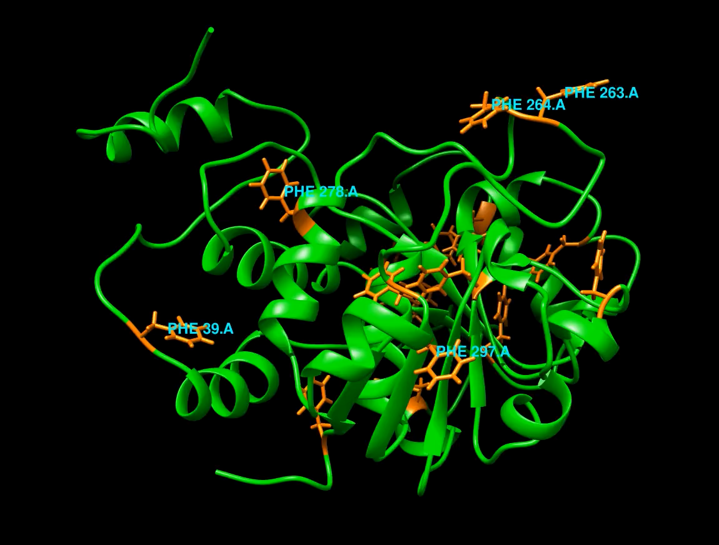
NMR Software
Gordon Chalmers
Complex Carbohydrate Research Center
Department of Computer Science

Slide 2
Outline
Describe output
Flow of software
Demonstration
User interface

Slide 3
Software
Software calculates NMR observables
MD2NOE_Protein - full trajectory
SingleFrameNMR – single frame, i.e. pdb
AssignSLP
Calculates noe’s, std-noe’s, for any initial/final proton spin boundary conditions
Boundary conditions specify the experiment
Std noe’s can be found by saturating any set of protons – user input

Slide 4
Trajectories versus single frame philosophy
2 versions of these packages – trajectory use and single pdb (i.e. frame)
If making the trajectory then use the trajectory programs, 5 days of calculation to make the trajectory then use an additional day to use the trajectory programs
Quicker, however, to use a single pdb

Slide 5
Peak lists - e.g. residue 29, 52 2ndRun – 1us
27 'H' 7.76 'VAL' -0.00147781 [] 50 'H' 7.814 'THR' -0.0106013 []
27 'HA' 4.033 'VAL' -0.0217196 [] 50 'HA' 4.299 'THR' -0.00507441 []
27 'HB' 2.06 'VAL' -0.0017263 [] 50 'HG1' 1.18 'THR' -0.00870412 []
27 'HG11' 0.916 'VAL' -0.00101694 [] 51 'H' 7.652 'ASP' -0.0387154 []
27 'HG12' 0.916 'VAL' -0.00094435 [] 51 'HA' 4.862 'ASP' -0.194463 []
27 'HG13' 0.916 'VAL' -0.00096793 [] 51 'HB2' 2.744 'ASP' -0.106253 []
28 'H' 8.15 'LYS' -0.0609504 [] 51 'HB3' 2.744 'ASP' -0.125268 []
28 'HA' 4.208 'LYS' -0.352942 [] 52 'HA' 4.213 'PHE' -0.0923055 []
28 'HB2' 1.762 'LYS' -0.0573981 [] 52 'HB2' 3.025 'PHE' -0.143013 []
28 'HB3' 1.762 'LYS' -0.0577634 [] 52 'HB3' 3.025 'PHE' -0.153327 []
28 'HG2' 1.367 'LYS' -0.0532805 [] 52 'HD1' 7.138 'PHE' -0.0592116 []
28 'HG3' 1.367 'LYS' -0.0532223 [] 52 'HE1' 7.248 'PHE' -0.0164106 []
28 'HD2' 1.59 'LYS' -0.00830207 [] 52 'HE2' 7.248 'PHE' -0.017756 []
28 'HD3' 1.59 'LYS' -0.00877297 [] 52 'HD2' 7.138 'PHE' -0.062337 []
28 'HE2' 2.9183 'LYS' -0.00236122 [] 53 'HD2' 2.785 'PRO' -0.0059309 []
28 'HE3' 2.9178 'LYS' -0.0020744 [] 53 'HD3' 2.785 'PRO' -0.00690574 []
28 'HZ1' 7.5274 'LYS' -0.00036189 [] 53 'HB3' 1.223 'PRO' -0.0168703 []
29 'HA' 4.56 'PHE' -0.121254 [] 53 'HA' 3.0431 'PRO' -0.0461835 []
29 'HB2' 2.97 'PHE' -0.10901 [] 54 'H' 6.7166 'PHE' -0.0152177 []
29 'HB3' 2.97 'PHE' -0.113241 [] 54 'HB2' 3.0325 'PHE' -0.0081486 []
29 'HD1' 7.186 'PHE' -0.0259221 [] 54 'HD2' 6.546 'PHE' -0.00882616 []
29 'HE1' 7.161 'PHE' -0.00334137 [] 55 'H' 7.9745 'ASN' -0.0229497 []
29 'HZ' 7.061 'PHE' -0.00134347 [] 55 'HA' 4.7522 'ASN' -0.00823382 []
29 'HE2' 7.161 'PHE' -0.0105852 [] 55 'HB2' 2.9294 'ASN' -0.0139195 []

Slide 6
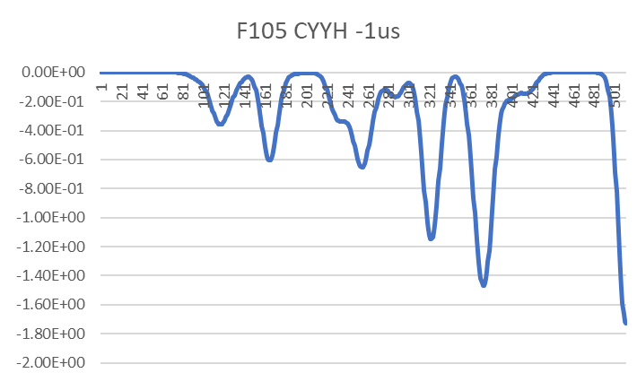
Example 1d noe

Slide 7
Single frame
Uses sphere approximation

Slide 8
Output of SingleFrameNMR – distance info
input and output files are :
rST6Gal1-3cyx-2ndRun-f10001.pdb | rST6Gal1.3cyx.2ndRun.bare.prmtop
./noe_output_rST6Gal1-3cyx-2ndRun-f10001.pdb.csv
time of creation Tue Nov 13 14:50:59 2018
spin pair | proton numbers |  | ResName | ResNumber | Proton | ResName | ResNumber | ProtonName | r | r^6 | 1/r^6
0 | 1 | 2 | PRO | 1 | H2 | PRO | 1 | H3 | 1.5972 | 16.6019 | 0.060234
0 | 2 | 1 | PRO | 1 | H3 | PRO | 1 | H2 | 1.5972 | 16.6019 | 0.060234
1 | 1 | 4 | PRO | 1 | H2 | PRO | 1 | HD2 | 2.85082 | 536.81 | 0.001863
1 | 4 | 1 | PRO | 1 | HD2 | PRO | 1 | H2 | 2.85082 | 536.81 | 0.001863
2 | 1 | 5 | PRO | 1 | H2 | PRO | 1 | HD3 | 2.28571 | 142.603 | 0.007012
2 | 5 | 1 | PRO | 1 | HD3 | PRO | 1 | H2 | 2.28571 | 142.603 | 0.007012
3 | 1 | 7 | PRO | 1 | H2 | PRO | 1 | HG2 | 4.12883 | 4954.1 | 0.000202
3 | 7 | 1 | PRO | 1 | HG2 | PRO | 1 | H2 | 4.12883 | 4954.1 | 0.000202
4 | 1 | 8 | PRO | 1 | H2 | PRO | 1 | HG3 | 3.45209 | 1692.35 | 0.000591
4 | 8 | 1 | PRO | 1 | HG3 | PRO | 1 | H2 | 3.45209 | 1692.35 | 0.000591
5 | 1 | 10 | PRO | 1 | H2 | PRO | 1 | HB2 | 3.707 | 2594.99 | 0.000385
5 | 10 | 1 | PRO | 1 | HB2 | PRO | 1 | H2 | 3.707 | 2594.99 | 0.000385
6 | 1 | 11 | PRO | 1 | H2 | PRO | 1 | HB3 | 4.22843 | 5715.76 | 0.000175

Slide 9
Trajectory analog
Noe_by_ISPA – another package
Calculates distance quantities from trajectory
r, 1/r^6, 1/r^3
Can be used to show existence and roughly estimate noe’s of any type

Slide 10
Order parameters – used to improve RDC back calculation
Info for PHE:105:H PHE:105:N
topology/trajectory rST6Gal1.3cyx.2ndRun.bare.prmtop
trajectory_no_tumbling.crd
atoms : 1683 1682
average <x1>,<y1>,<z1> - over frames
25.4248 66.9054 29.0723
average <x2>,<y2>,<z2> - over frames
25.8482 66.0738 28.8178
'bond length' normalized <x1>,<y1>,<z1>
26.5478 69.8606 30.3564'bond length' normalized <x2>,<y2>,<z2>
26.9899 68.9922 30.0906average distance - average over frames
1.01
order parameter <(3cos^2-1)/2>
0.878571
average fluctuation: Sxx,Syy,Sxy,Sxz,Syz
-0.4365240
.2597090
.1865950
.01341110
.07280940
.405442
N-H bond distance information, including
‘bond length corrected’ distances
Order parameter tensors, e.g. used in Redcat
Option for Ca-H for these RDC’s

Slide 11
SingleFrameNMR 3J couplings
3J coupling output
input and output files are :
rST6Gal1-3cyx-2ndRun-f11001.pdb rST6Gal1.3cyx.2ndRun.bare.prmtop
./3J_coupling_output_rST6Gal1-3cyx-2ndRun-f11001.pdb.csv
text file is also included in output - separate file
time of creation Tue Nov 13 14:22:58 2018
check reference document.
curve type | atom No.1 | atom No.2 | atom No.3 | atom No.4 | type 1 | type 2 | type 3 | type 4 | 3-bond | angle | coupling
Karplus66 | 0 | 3 | 6 | 7 | N | C | C | H | PRO:1:N-PRO:1:CD-PRO:1:CG-PRO:1:HG2 | -144.104 | 2.45768
Karplus66 | 0 | 3 | 6 | 8 | N | C | C | H | PRO:1:N-PRO:1:CD-PRO:1:CG-PRO:1:HG3 | 167.829 | 0.730323
Karplus66 | 0 | 12 | 9 | 10 | N | C | C | H | PRO:1:N-PRO:1:CA-PRO:1:CB-PRO:1:HB2 | 131.981 | 2.89671
Karplus66 | 0 | 12 | 9 | 11 | N | C | C | H | PRO:1:N-PRO:1:CA-PRO:1:CB-PRO:1:HB3 | 132.715 | 1.57176
Karplus105 | 0 | 12 | 9 | 11 | N | C | C | H | PRO:1:N-PRO:1:CA-PRO:1:CB-PRO:1:HB3 | 132.715 | 0.578436

Slide 12
Trajectory analog
3J_coupling_distribution package at Glycam
Does same calculation using the full trajectory
Also produces histograms of 3 bond torsion angles, i.e. phi/psi plots

Slide 13
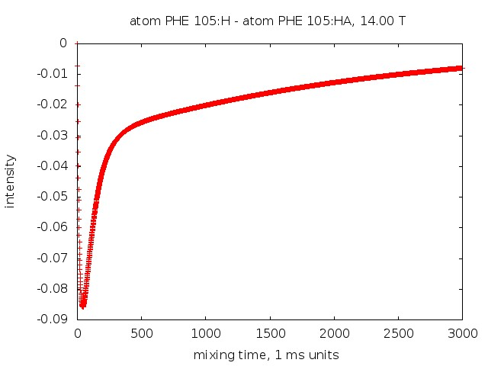
NOE Build-up Curves

Slide 14
Additional output
Internal correlation functions
Spectral density functions – can be used to calculate many nmr observables
Complete relaxation rate matrix

Slide 15
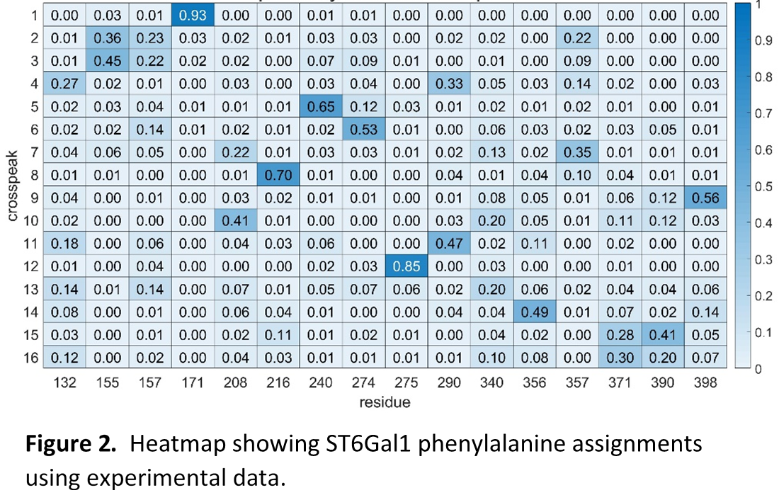
Assignment

Slide 16
In addition
User has a file with all possible assignments with scores
Verbose is an option – contains statistical information of each peak assignment

Slide 17
Output
Quite much output
However, user can skip to the end line without viewing any of it
1D noe vectors
Assignment
‘total script’ will calculate all of it and get there – essentially one command – run script

Slide 18
Flow charts
There are many ingredients
Flow of programs is important
MD2NOE_Protein partitioned for several reasons
Change of spectrometer – different B field
Change of experiment (e.g. selective or non-selective)
No need to recalculate and waste a day or more

Slide 19
2 types of average coordinates – N H corrected, usual
Many programs in these packages
Calculate order parameters
Order parameters, tensor
MD2NOE_Protein flow
spectrum in excel sheet and csv format
Calculate spectrum
Calculate internal correlation functions
Peak list
Calculate relaxation rate matrix
Correct for Amber nomenclature
Calculate nmr observables – noe buildup curves
Calculate predicted chemical shifts

Slide 20
Assign_SLP_MD Assignment flow
Noesy spectrum
Rdc’s, chemical shifts, weights
Order parameter files, predicted chsmical shift files
Make input files
Experimental measurements
Tedious, but recently much simplified
Probability density statistics figure of assignment
Input files, including calculated spectrum
Run genetic algorithm
Text file with possible solutions
Run output analysis program
Optional - Run statistics program
Validation

Slide 21
Flow of SingleFrameNMR
spectrum in excel sheet and csv format
Calculate spectrum
Calculate relaxation rate matrix
Peak list
Calculate nmr observables – noe buildup curves
Correct for Amber nomenclature
Calculate predicted chemical shifts
Not required for noe calculation

Slide 22
STD NOE’s
Currently generalized to calculate saturation transfer difference noe’s.
Not yet tested or used with experiment.
This generalization can be used with the trajectory, i.e. MD2NOE_Protein, or a single frame, i.e. SingleFrameNMR
Should add more utility to the previous work.

Slide 23
User inputs
The amount of inputs seems difficult. Currently reducing them and putting in more defaults.
‘Interface’ is designed to be user friendly
no need to open a single output file from MD2NOE_Protein – excel sheet, order parameter files are goal
No need to open any chemical shift files from ppmOne or shiftX2
File preparation for Assign_SLP_MD simplified – there is a program that does this from experimental input file.
E.g. no need to open any order parameter files or chemical shift prediction files
Can run the algorithm without doing anything except using the pre-made scripts modified for the protein

Slide 24
Documentation
There is documentation of every step of the calculation.
Has been tested and is sufficient for somebody to use the packages. - without me
Documentation is included, with presentations about the theory and software

Slide 25
Further
Simplify scripts somewhat – create ‘total’ script, one which you run as executable or Matlab script that
activates all parts of MD2NOE_Protein or Assign_SLP_MD.
Create GUI
Increase efficiency of calculations …
Memory management – deletion of unnecessary files after every step of calculation
Include more measurements in Assign_SLP_MD

Slide 26
Demonstration
Start SimpleFrameNMR calculation
Start complete relaxation rate calculation
Start noe curve calculations
Can not really demonstrate due to 1 hour limitation – output is already made

Slide 27
Additional background
Software can be used to improve experiment by increasing signal intensity
Can be used with small and large molecules – uses the sphere approximation
AssignSLP will be improved by using additional measurements, e.g. PRE’s, methyl RDC’s, methyl NOE’s, …
Next 2 slides

Slide 28
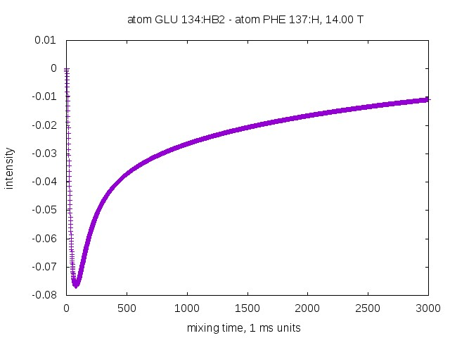
: negative
Bad signal
Good linear model
This is the case for proteins.
Can be used to maximize signal to noise. Especially if many spin pair measurements are to be maximized.
Good signal
Needs complete calculation
Example Noe curve and its use in improving experimental Signal to noise

Slide 29
Comment about sphere approximation
Key to working with large molecules – effectively ‘extend’ trajectory by adding artificial bulk tumbling
Cannot calculate this noe
Can calculate

Slide 30
User interface
At the moment scripts are used to activate
GUI will eventually be made
Inputs are going to be simplified by eliminating some of the inputs and by using defaults

Slide 31
Conclusion
Several comprehensive packages for comparing molecular modeling to experiment
Still some work to do in simplifying the inputs and user interface
Has been tested with many proteins and carbohydrates

Slide 32
Collaborators
Seems like a lot of work and it was
James H. Prestegard
Rob Woods
Kelly Moreman (experimental with proteins)
Qi Gao (1st Assignment package)
Alex Euletsky
Rob Williams (has also beta tested without my interaction)
Laura Morris
Currently giving a set of talks in the Prestegard meeting about how to use, and feedback is being used to improve the user experience

